Slide 1
Parent Workshop ALL THE THINGS YOU NEED TO KNOW ABOUT Moscrop Math Honors!!! (Grade 7 Entrance Exam)
© Copyright all rights reserved to Homework depot: www.BCMath.ca

Slide 2
Entrance Exam Information
Entrance Exam: 1hour and 45 minutes
Start at 3:45pm and END around 5:30pm
100 students participating in the entrance exam
Top 30 students will be selected for Math 8 Honors
If there is a “NEED” we will consider running a 2nd Math 8 Honors class

Slide 3
What is Presentation ABOUT?
Introduction to Teachers of Math Department at Moscrop
What Courses to Take in Math Honors Program
Philosophy/Goals/Preview of the Honors Program
What to do if your child is ACCEPTED to the Math Honors Program
What to do if your child is NOT ACCEPTED to the Math Honors Program
Question and Answer Period
Q/A with Students and Alumni's

Slide 4
Math Department At Moscrop
Mr. Young (M10/11H, M12H, AP Stats) danny.young@burnabyschools.ca
Ms. Wu (M8H, M9H) cindy.wu@burnabyschools.ca
Mr. Chang (Math 8/AP Calc) sith.chang@burnabyschools.ca
Ms. Langille (Math Depart. Head) stephanie.langille@burnabyschools.ca
Mr. Depaco (Calculus 12) greg.depaco@burnabyschools.ca
Mr. Cheong (Math 8) chester.cheong@burnabyschools.ca
Mr. Cheng (Math 9) nick.cheng@burnabyschools.ca
Ms. DeSantis (Math 9) briana.desantis@burnabyschools.ca
Ms. Kaur
Mr. Hartman
Mr. Chin (Principal) andy.chin@burnabyschools.ca
Ms. Vancic (DH Counsellor) olga.vancic@burnabyschools.ca

Slide 5
Math Honors COURSES at Moscrop:
Math 8 Honors
Math 9 Honors
Math 10/11 Honors
Math 12 Honors
AP Statistics
AP Calculus

Slide 6
Additional Courses for Math
JUNIOR COURSES: (LUNCH)
Math Challengers Workshops for Grade 8 (Tuesdays)
Math Challengers Workshops for Grade 9 (Wednesdays)
SENIOR C OURSES: (AFTERSCHOOL - Thursday)
Advanced Algebra 12
Advanced Number Theory 12

Slide 7
What is Our Goal?
We aim to build a thriving math community where students grow together and see math as something exciting, inspiring, and worth pursuing.
“Community” - students learn math together, Large,
“Culture” - Math is cool, Students LOVE math
Classes are Engaging, Meaningful, and Inspiring.
HELP our students LOVE math and also become very GOOD in Math

Slide 8
What is Our Philosophy?
We DON”T make things easy—we wants students to grow. Our program meets students where they’re at, then challenges and supports them to rise higher
Students are challenged based on their ability & readiness.
Heavy emphasis on problem solving
Build thinkers and not rule-followers/procedures
Students are taught to take initiative in their learning.

Slide 9
What DOES OUR Program Look Like?
Our students thrive. They engage, collaborate, challenge themselves, and reach remarkable heights in mathematics—together.
Provincial & National Results in Math Competitions
High Participation Rate (Over 10%)
Students Succeed at a High Level
Thriving Math Culture Afterschool

Slide 10
#1 in Canada for the Canadian National Math League (CNML), announced just last week!
1st in BC for the CIMC (CEMC Intermediate Contest) from Waterloo.
3rd in BC for the CSMC (CEMC Senior Contest).
In previous years:
1st in BC for the Cayley contest
2nd in BC for Pascal and Galois
11 students qualified for the American Invitational Math Exam (AIME), one of the most competitive math contests in North America.
Over 160 students registered for the Pascal, Cayley, and Fermat contests this year—more than 10% of our entire school!
Nearly 120 students participated in the CIMC and CSMC.
8 of our Grade 11 students were invited to the Lloyd Auckland Mathematics Workshop, a prestigious summer program hosted by the University of Waterloo—open only to top contest performers across Canada.

Slide 11
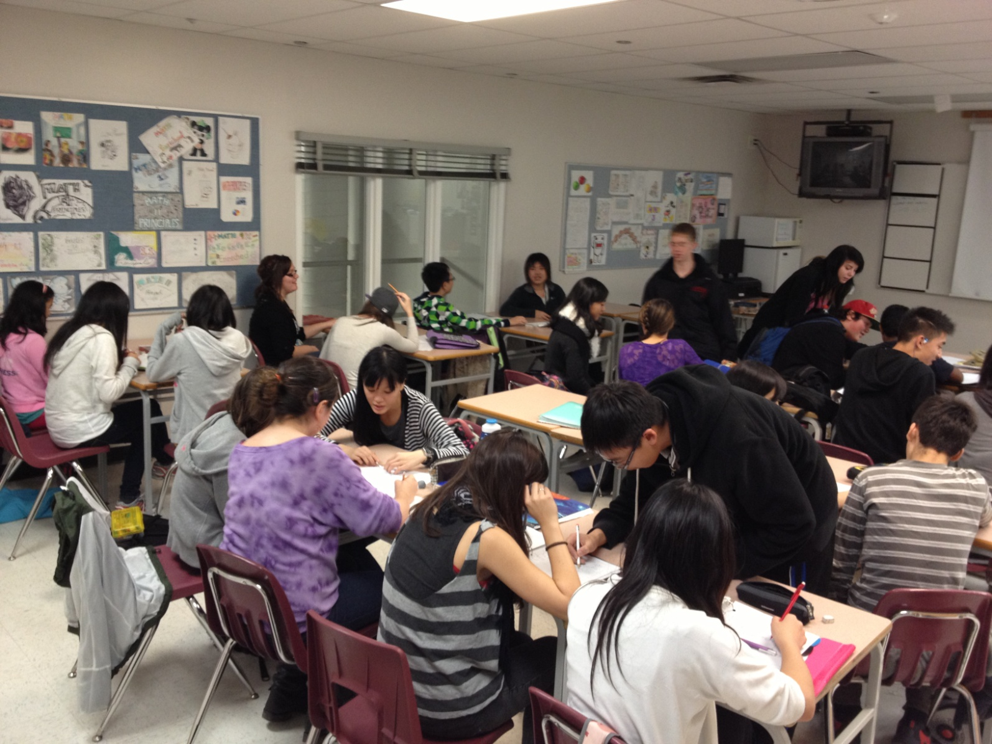
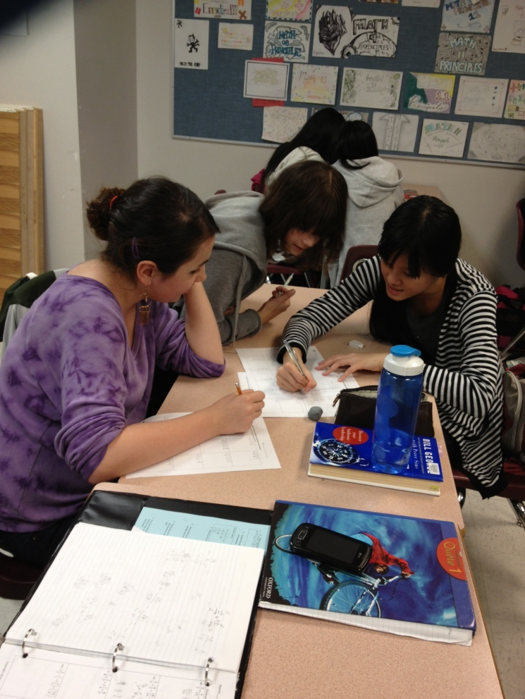

Slide 12
Q: What to DO if your Child is Accepted?
STUDENT
Adjust
Learn to be a good student
Homework
Be easy to teach
Attentive & engaged
Be ready to learn
Take Ownership
Emphasize Learning Over Grades
Student NEEDS to Want it MORE than the TEACHER
PARENT
SUPPORT and ENCOURAGE
GROWTH takes TIME
It’s OK to struggle
Encourage Student to take Responsibility – FLEX, study groups, ask for help, develop proper study habits
Be informed: TEAMS, MyED
DON’T Compare, Shame, Blame
Limit Video Games/Phone

Slide 13
Q: What to Do if Your Child is NOT accepted?
STUDENT
KEEP trying and GET help
Do the Math Honors Homework
RESOURCES are available on TEAMS & BCMath.ca
Attend LUNCH sessions with Ms Wu (Tuesdays Gr 8)
Student NEEDS to Want it MORE than the TEACHER
PARENT
SUPPORT and ENCOURAGE
Encourage Student to take Responsibility – FLEX, study groups, ask for help, develop proper study habits
Be informed: TEAMS, MyED
DON’T Compare, Shame, Blame
Limit Video Games/Phone

Slide 14
Names of PEER TUTORS:

Slide 15
www.BCMath.ca
Notes:
All my resources are online at bcmath.ca

Slide 16
Q and A with STUDENT and Alumni’s
Winnie Wu – UBC 4th year, Financial Management Program
Jenise Yang – UBC 1st Year, Business, scholarship
Sisi Jiang – Grade 12, AP Calculus, Waterloo
Claire Xiang – Grade 12, AP Calculus, Waterloo
Alice Wang – Grade 12, AP Calculus, Waterloo
Mia Guo – Grade 11, Math 12 Honors
Purna Gupta – Grade 11, Math 12 Honors
Anushka More – Grade 11, Math 12 Honors

